Slide 1
Monthly Update on 2018-2019 WRAP Workplan
January 29th, 2020
TSC and Work Group Co-Chairs Call
Tribal Data WG
Fire and Smoke WG
Oil and Gas WG
Regional Technical Operations WG
Regional Haze Planning WG

Slide 2
Tribal Data Work Group

Slide 3
Workplan Progress & Coordination by the Tribal Data Work Group
Workplan Progress over the Last Month
  Extension drafted for remaining task/budget for ITEP/EN3 project contract (13 page Tribal oil & gas report by EN3)
  SOW for 2020 work provided by ITEP; discussion on TDWG calls of focus for 2020 activity: 1. technical assistance for tribes with state SIP (or related) reviews; possibly 2. continued work on tribal contacts list
Workplan Coordination Occurring over the Last Month
  Tribal oil & gas report by EN3 was shared with OGWG

Slide 4
Tribal Data WG Remaining Workplan Tasks
Task | Deliverable/Source | Expected Delivery Date
ITEP Project 1.4 | Final EN3 (13 pg) oil & gas tribal data report | Cut off for comments from OGWG is 1/31/20. No date yet for final draft
TDWG appdx task- Tribal membership in WRAP | Participation letter- distributed. | Tom’s draft due 1/24/20, cut off for TDWG comments is 2/5. No date yet for distribution
Web list updates | Project update list with “Complete” tasks (1.1.4, 1.5, 1.6) | Not yet discussed

Slide 5
Fire and Smoke Work Group

Slide 6
Workplan Progress by Fire and Smoke Work Group
Workplan Progress over the Last Month
  Workgroup reviewed progress on new Smoke Management Layer on WRAP map
  Consultant developed two Future Fire Scenarios for Regional Haze modeling (submitted to modelers?)
  Workgroup discussed the draft FETS Transition Action Plan
  Another call planned for early February to review the final WRAP workplan task

Slide 7
Fire and Smoke WG Remaining Workplan Tasks
Task | Deliverable/Source | Expected Delivery Date
VI. Wildfire coordination between states/tribes on wildfire response and smoke management | a. Determine how states, tribes, and federal agencies coordinate (or don’t) during wildfire season b. Identify ways to improve coordination | Need to discuss

Slide 8
Oil and Gas Work Group

Slide 9
Workplan Progress & Coordination by Oil and Gas Work Group
Workplan Progress over the Last Month
  OGWG and Project Management Team (PMT) review and feedback
  Tasks 2, 3, 4 – Underway
Workplan Coordination Occurring over the Last Month
  Jan 21 – Project Management Team Call
  OGWG and PMT review and feedback on draft work products
    Final Draft Edition for TDWG - EN3's comparative evaluation of inventories of tribal oil- and gas-production-related emissions sources
    Alternate Scenarios Draft Report/Memo (2 scenarios included) & spreadsheets
    Additional Reasonable Controls Report/Memo
    Agency Input to describe state programs

Slide 10
Oil and Gas WG Remaining Workplan Tasks
Task | Deliverable/Source | Expected Delivery Date
12.1 | Regional Haze Planning Technical Support
4.2 | Task 2) Forecast Scenarios 2 & 3 (OTB & OTW Controls) | February 2020
5.0 | Task 3) Forecast Scenarios (Additional Reasonable Controls) | February 2020
12.2 | Oil and Gas Associated Regional Analysis Technical Support
 | Task 4) Agency Program Review Memo | February 2020
Workgroup Coordination Upcoming:
  February 11, 2020 – OGWG Bi-Monthly Call
    Workgroup consensus on remaining work products
    Workgroup Self-Assessment to determine future direction and needs of OGWG in the upcoming year

Slide 11
Regional Technical Operations Work Group

Slide 12
Workplan Progress & Coordination by RTOWG
Workplan Progress over the Last Month
  Review of 2014v2 CAMx model performance evaluation
Winter (left) and summer (right) simulated sulfate bias

Slide 13
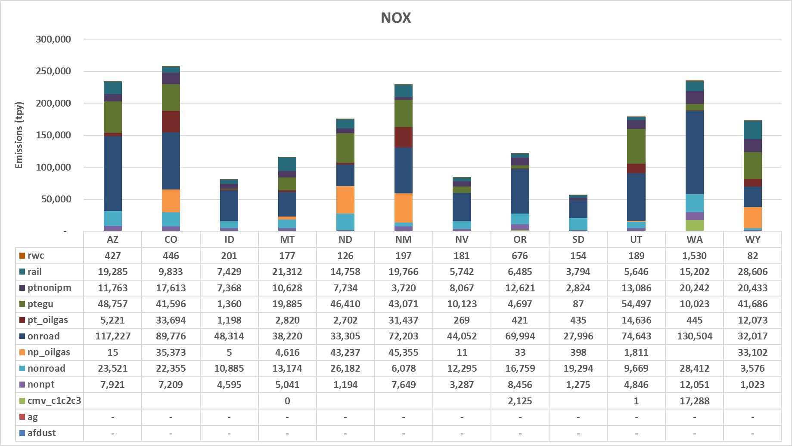
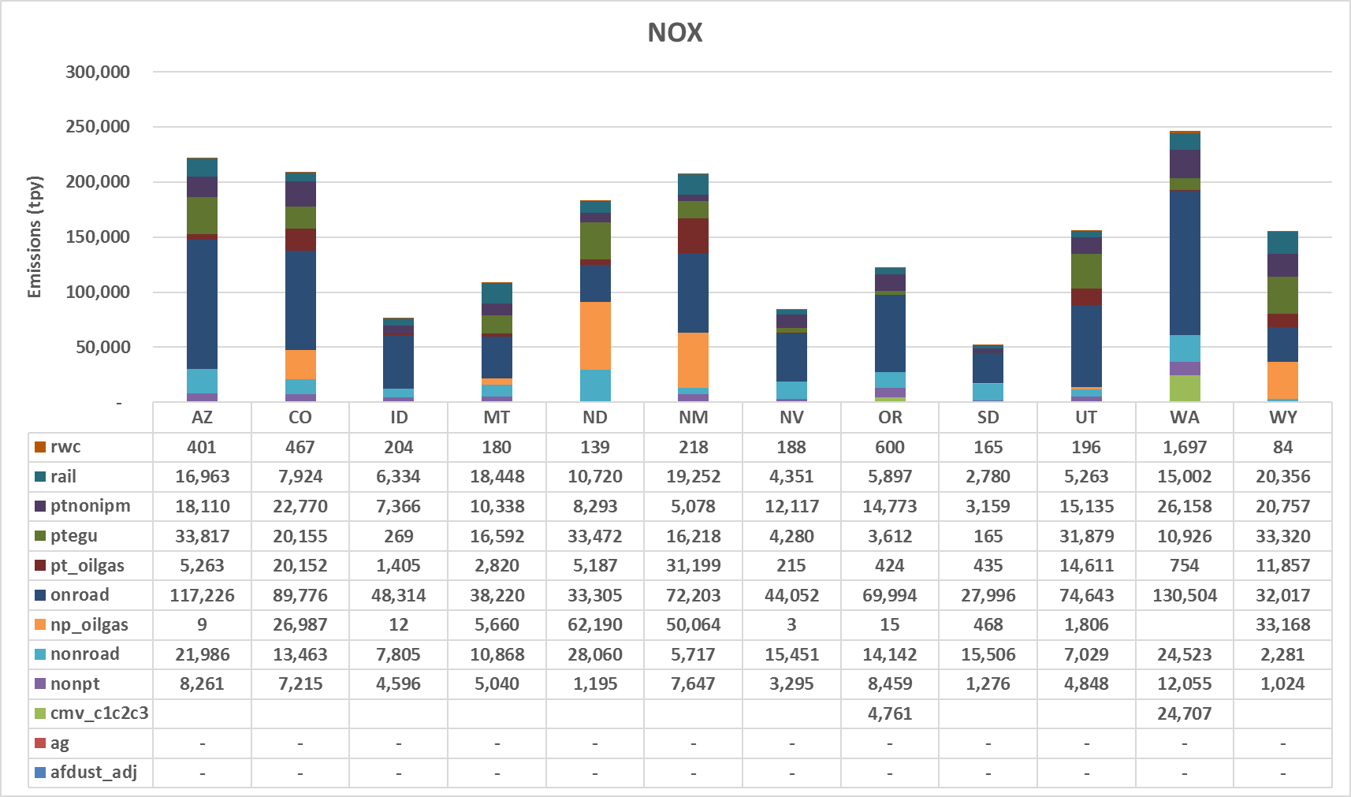
Workplan Progress & Coordination by RTOWG
Workplan Progress over the Last Month
  Comparison of 2014v2 and representative baseline emissions
2014v2 (left) and representative baseline (right) NOx emissions by state and sector

Slide 14
Workplan Progress & Coordination by RTOWG
Workplan Coordination Occurring over the Last Month
  IWDW-WAQS Technical Committee Meeting, Fort Collins, 12/18/19
  RTOWG call, 1/22/20
    Review of CAMx 2014v2 MPE
    Representative baseline emission inventory comparison
    Spec sheet for representative baseline source apportionment run
  Weekly RTOWG co-chair calls
  Weekly coordination call with Ramboll
  Participation on other workgroup calls

Slide 15
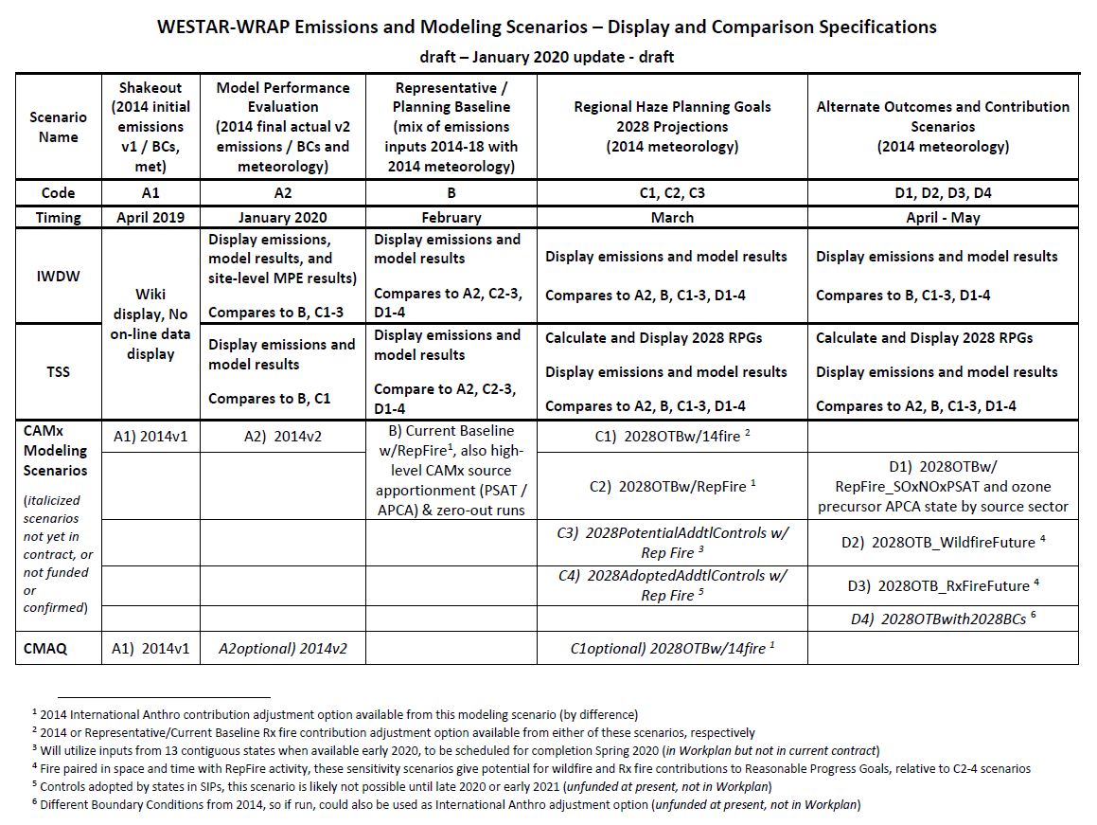
RTOWG Remaining Workplan Tasks
This table includes 2018 -2019 WRAP Workplan tasks:
3.7 - Conduct/evaluate 2028 air quality modeling
4.2 – Sensitivity/control strategy evaluation modeling for 2028
4.3 – Evaluate base year & 2028 source apportionment results
4.4 - Evaluate change in visibility from base year to 2028
10.5 - IWDW-WAQS 2028 on-the-books air quality modeling
10.6 – IWDW-WAQS FY source apportionment/sensitivity modeling
10.7 – IWDW-WAQS 2028 control scenarios’ air quality modeling

Slide 16
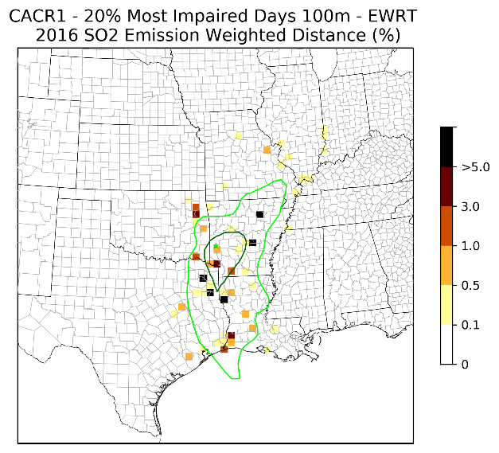
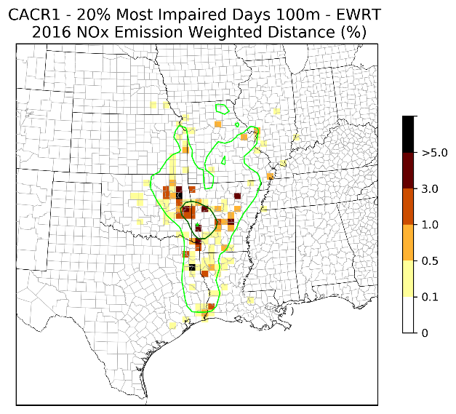
RTOWG Remaining Workplan Tasks
Weighted Emissions Potential (WEP) analysis for 2028 on-the-books (Task 2.4)
Dynamic model evaluation for 2002, 2014 and 2028 (Task 3.3)

Slide 17
Regional Haze Planning Work Group

Slide 18
Workplan Progress & Coordination by the Regional Haze Planning Work Group
Workplan Progress over the Last Month
  Reviewed the Regional Haze Storyboard
  Reviewed EPA’s ICR and the subsequent WRAP/WESTAR memo
  Approved the FAQs for the TSS v.2 website
  Discussed conforming work products to the American’s with Disabilities Act
Workplan Coordination Occurring over the Last Month
  Coordination and Glidepath Subcommittee, FAQs and Storyboard
  RTOWG, discussed modeling the Control Measures Scenario

Slide 19
RHPWG Remaining Workplan Tasks
Task | Deliverable/Source | Expected Delivery Date
2.3 Develop and refine 2028 forecasts | Refined 2028 control measures inventory | March 2020
5.5 Identify 2028 emission reductions from control strategies and incorporate in 2028 inventory | Tribes, states, and locals provide revisions to 2028 emission inventory reflecting application of controls | February/ March 2020

Slide 20
Workplan Progress & Coordination by the Control Measures Subcommittee
Workplan Progress over the Last Month
  Call was held on November 25th
  States in various stages of 4-factor analysis work
  Next call on January 27th
Workplan Coordination Occurring over the Last Month
  none

Slide 21
Control Measures Subcommittee Remaining Workplan Tasks
Task | Deliverable/Source | Expected Delivery Date
5.4 States conduct 4-factor control measures analysis | WRAP states 4-factor review of RP sources – western states are in various stages of review | Spring 2020
5.5 Identify 2028 control strategies and incorporate in 2028 inventory | WRAP states still conducting 2028 control strategy review | Spring 2020

Slide 22
Workplan Progress by
Coordination and Glide Path Subcommittee
January meeting canceled, next meeting Feb 13, 2020
Workplan Progress for December
  Elevated TSS FAQ Document to RHPWG
  Reviewed TSS Glossary for missing terms
  Reviewed of Emissions and Modeling Scenarios Comparison Specs
  TSSv2 Delivery Update Presentation
  IMPROVE Steering Committee Input
Workplan Tasks for the Next Two Month
  Continue overview of TSSv2 development
  Gain consensus on TSS FAQ and Glossary
  Revisit TSS Priorities document
  Support creation of RH Storyboard

Slide 23
Coordination and Glide Path Subcommittee
WG Remaining Workplan Tasks
Task | Deliverable/Source | Expected Delivery Date
6.1 Assess needs for materials useful to SIP planners | Regular queries to SC leads and states Determine capacity of RHPWG and Subcommittees to meet state-identified needs, delegate lead responsibility for appropriate tasks, and communicate decisions back to states | Ongoing through 2021
6.2 Identify and compile existing materials | Centralized list of/links to useful references and resources related to training and outreach Examples of training and outreach materials or methods used by states/locals/tribes | Summer 2020
6.3 Develop new materials | High-level overview of RH planning Glossary – haze-related terms FAQs Storyboard – Haze in the west Webinar presentations to states Other resources | Ongoing through 2020
6.4 Oversee completion and distribution of materials | Share working drafts Document docketing process Determine appropriate posting location(s) Schedule and support/facilitate training webinars | Ongoing through 2020 (See TSS Docketing Process and WRAP/TSS Posting)

Slide 24
Coordination and Glide Path Subcommittee
WG Remaining Workplan Tasks
Task | Deliverable/Source | Expected Delivery Date
7.1 Review TSS v1 for priority needs | Priority needs document | Spring 2020
7.2 Coordinate and review TSS v2 monitor data tool development | Haze analysis tool Visibility summary tool | Ongoing through 2020
7.3 Coordinate and review TSS v2 emissions data and projections tool development | 2014 emissions inventory tool 2028 emissions projections tool (base case and control measures scenario) | Ongoing through 2020
7.4 Coordinate and review TSS v2 base year modeling tool development | Base year modeling results tool | Not yet started, refer to revised modeling timeline
7.5 Coordinate and review TSS v2 2028 on-the-books modeling results tool development | 2028 base case modeling tool | Not yet started, refer to revised modeling timeline
7.6 Coordinate and review TSS v2 reasonable control modeling tool development | Reasonable control scenario modeling tool | Not yet started, refer to revised modeling timeline
7.7 Provide TSS training webinars | Periodic webinars integrated with topics for educational outreach efforts (see Task 6.4 above) | Ongoing through 2020

Slide 25
Coordination and Glide Path Subcommittee
WG Remaining Workplan Tasks
Task | Deliverable/Source | Expected Delivery Date
8.3 Coordinate and support informal consultation among WRAP member agencies | Keep record of WRAP-facilitated meetings and conference calls Prepare and disseminate communication log template and other communication templates, as needed, for use by states Support regional information sharing and informal consultation between agencies throughout analysis and SIP development tasks, and beyond, as needed | Ongoing through July 2021
8.4 Support state-led SIP development, formal consultation, and public review for July 31, 2021 submission to EPA | Provide a regional forum to support coordination regarding the following state tasks: -Formal FLM Consultation Public Notice Period Potential Hearing Response to Public Comments Record included in RH SIP Appendix Packaging for Submittal to U.S. EPA | 2020 through July 2021 (depends on State schedule)

Slide 26
Workplan Progress & Coordination by RHPWG Emissions Inventory & Modeling Protocol SC
Workplan Progress over the Last Month
  Mobile source EI future projections completed
  CAMx 2014v2 Base Case model performance evaluation
Workplan Coordination Occurring over the Last Month
  Coordinate with other subcommittees, states, and contractor as needed to review/update emissions as needed.
  Share info with states/locals about linkage between 4-factor analyses and controls scenario modeling inputs

Slide 27
Emission Inventory & Modeling Protocol Sc
Remaining Workplan Tasks
Task | Description | Expected Delivery Date
3.6 Base Year Modeling | Report on results of base year visibility, source apportionment modeling, and model performance evaluation | Feb 2020
3.7 Future Year Modeling | Report on results of future year visibility, source apportionment, sensitivity modeling, and control scenario modeling | March 2020
4.2 Evaluate 2028 sensitivity & control strategy modeling | RTOWG contractor-supported report presenting results of sensitivity testing | March 2020
4.3 Evaluate 2028 source appointment modeling results | RTOWG contractor-supported report on results of source apportionment | March 2020
4.4 Evaluate change in visibility from base year to 2028 | RTOWG contractor-supported report on Reasonable Progress Goals Assessment of visibility change | March 2020
5.4 Evaluate emission source impacts on CIAs | RTOWG – contractor supported Weighted Emissions Potential (WEP) analysis that will provide WEP maps of source areas impacting each Class I area | April 2020

Slide 28
End of Workplan Progress Update

